Slide 1
Microservices and DevOps
DevOps and Container Technology
Security 101 - Authorization
Henrik Bærbak Christensen

Slide 2
/introspect
In Mandatory 2.1 you will be strangling the daemon…
  Migrate from a monolith to a set of microservices
Example
  Daemon does not handle messages in the room
    It asks a MessageService to do that on behalf of it
That is, A down stream service that needs to validate token
  Because it is only a authorized player that may interact with the message service, right?

Slide 3
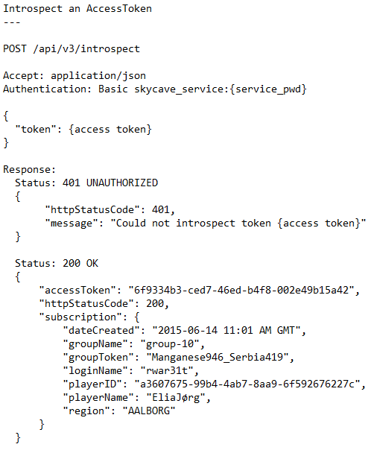
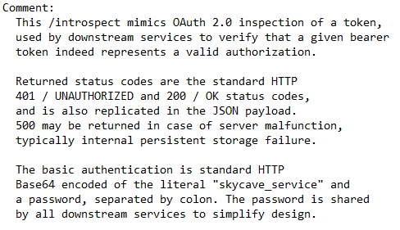

API
A single token for all services
56utxf8tqv

Slide 4
Note of Caution
It is rather tedious, so to lower implementation burden on you and on the consuming groups…
Do not implement it or make it optional
  If there is not Authorization header in REST payload, then ignore it and allow access!

